Slide 1
ASP.NET MVC
Les 1: Introduction

Slide 2
Introduction
ASP.NET MVC
Getting Started
Adding a Controller
Adding a View
Razor
HTML & TAG Helpers
Copy code from https://itf-wpf.netlify.app/ASP/

Slide 3
HoW?
Part 1: from scratch
Part 2: using templates
Without Bootstrap (focus on ASP.NET)
Writing Controllers/Views ourselves
Example: MvcMovie
Exercise: MotoGP
With Bootstrap
Scaffolding
Example: Contoso University
Exercise: Music Store

Slide 4
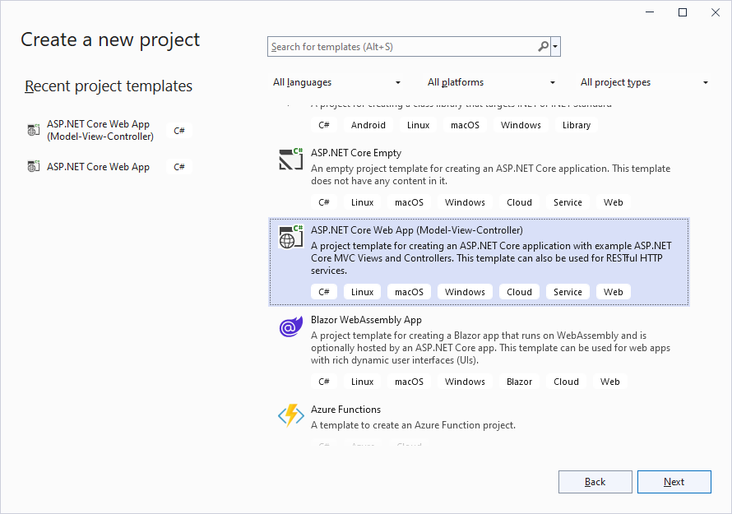
Getting started
Create a folder www (save all your webapplications in this folder)
Visual Studio 2022
Create New Project
ASP.NET Core Web App
(Model-View-Controller)
Next

Slide 5
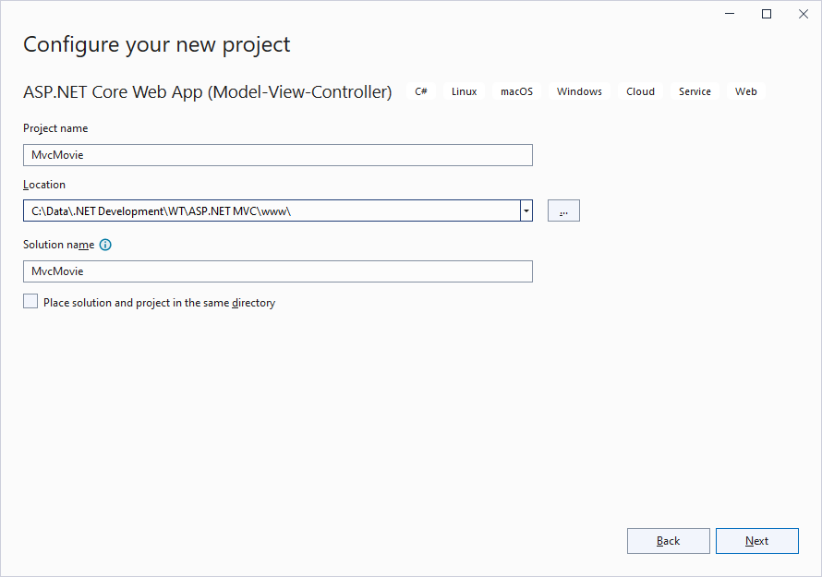
Getting started
MvcMovie
www folder
Next

Slide 6
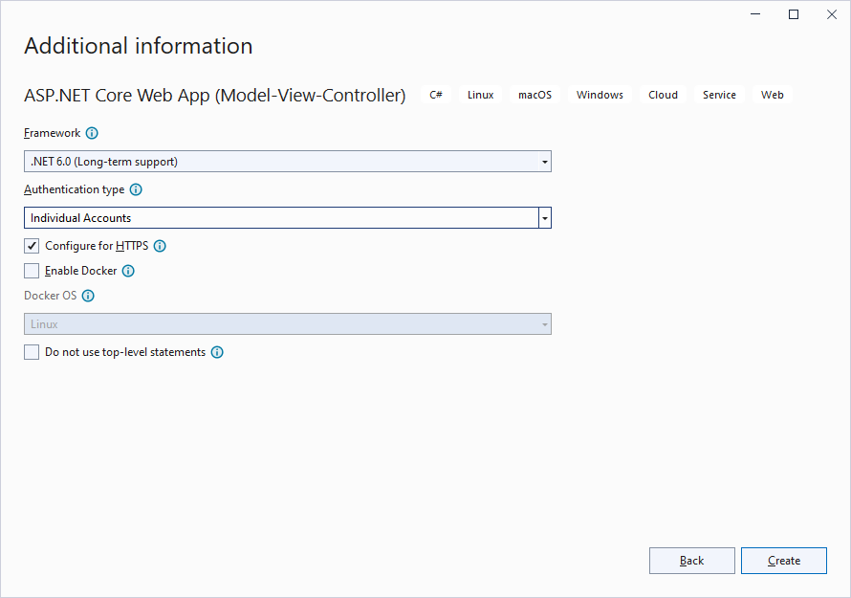
GETTING STARTED
.NET 6.0
Authentication type: Indivual Accounts
Create

Slide 7
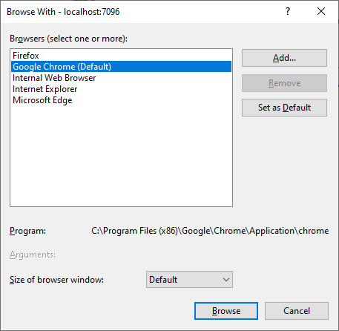
Default Browser
File|Browse With…
Chrome
Set as Default

Slide 8
RunNING THE PROJECT
F5: debug-mode (start button)
You need to stop your application (top button) before you can make changes to your code
Ctrl-F5: non debug-mode (better for web development)
No need to stop the application for modifications, just save your code and rebuild to see the new version (hot reload)
Ctrl-F5:
Compilation of the project
Starting local webserver
Calling the default controller and showing the result in the defaut browser
Accept (once) the Server Security Certificate

Slide 9
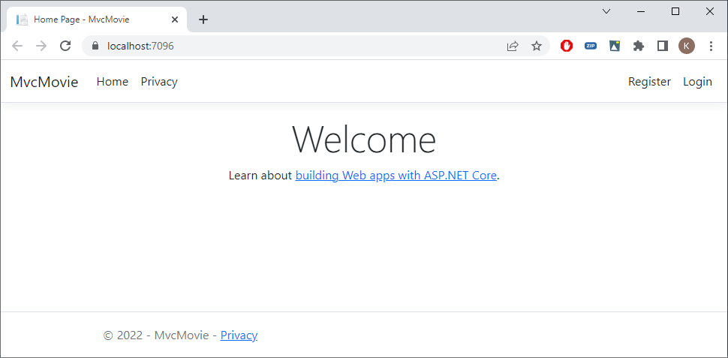
Running the project

Slide 10
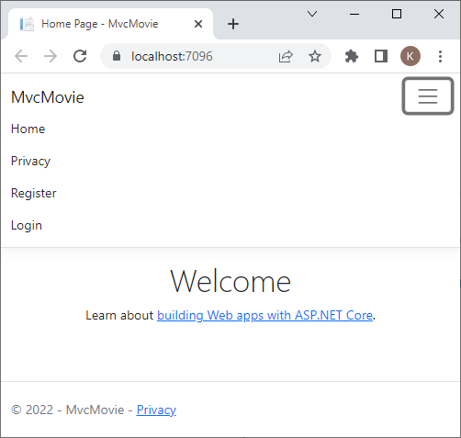
Bootstrap

Slide 11
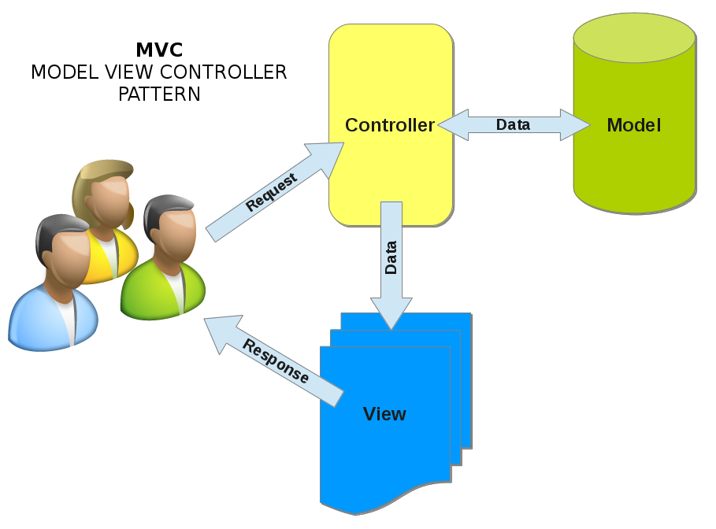
MVC

Slide 12


URL Segments
localhost:xxxx/Controller/Action
localhost:xxxx/Home/Index
localhost:xxxx
Program.cs ⇨ default route
Controller (default=Home)/Action (default=Index)/id (parameter is optional)

Slide 13
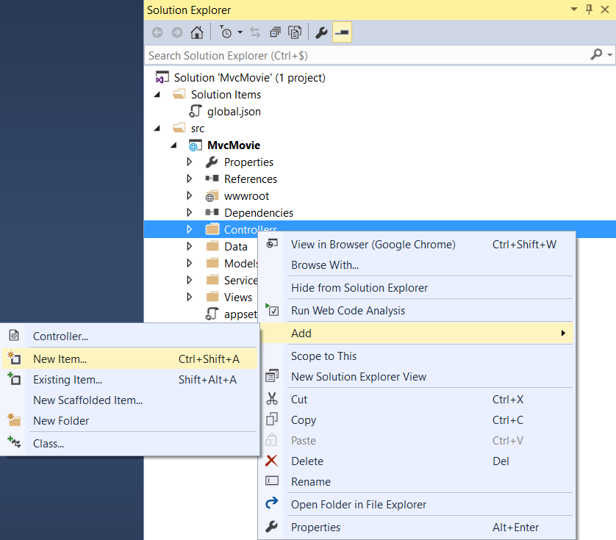
Adding a controller
Don't use scaffolding for now

Slide 14
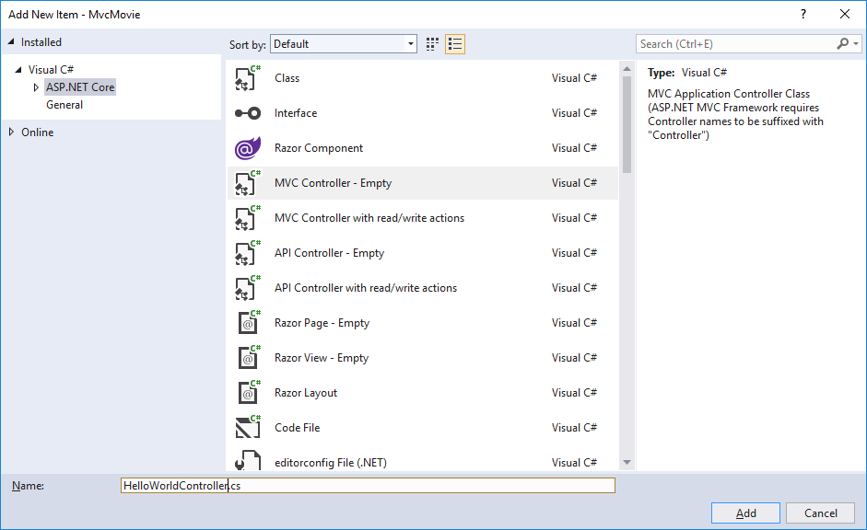
Adding a Controller ⬄ Class
HelloWorldController.cs

Slide 15
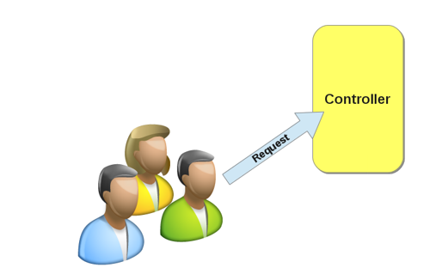
Class methods ⬄ Actions
namespace MvcMovie.Controllers
{
public class HelloWorldController : Controller
{
// GET: /HelloWorld/
public string Index()
{
return "This is my default action...";
}
// GET: /HelloWorld/Welcome
public string Welcome()
{
return "This is the welcome action method...";
}
}
}

Slide 16
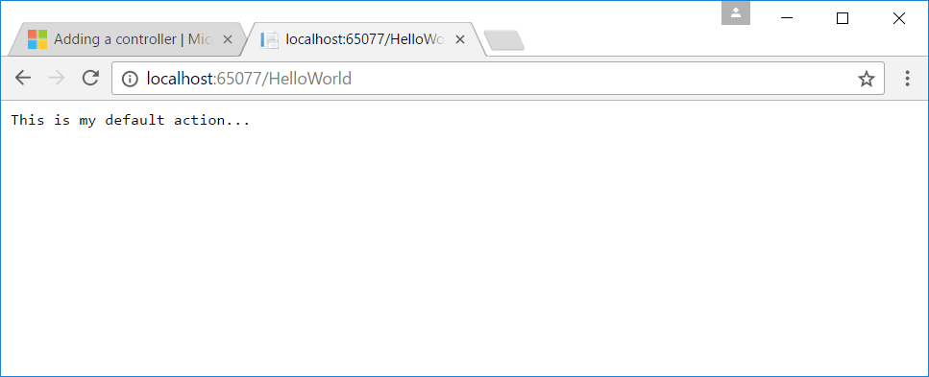
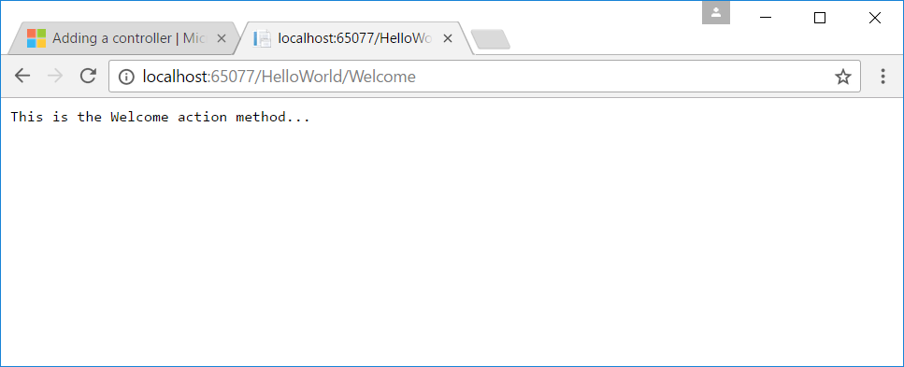
Class mapping
localhost:xxxx/HelloWorld
maps to
HelloWorldController Class

Slide 17
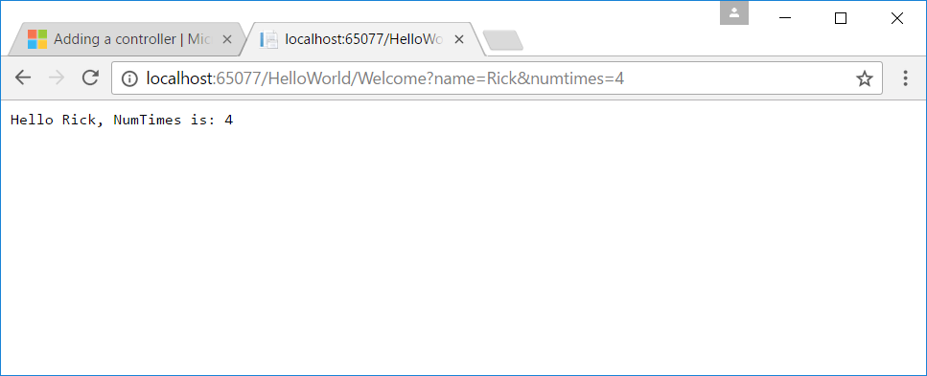
Parameters (1. query string ⇨ ?)
// GET: /HelloWorld/Welcome
public string Welcome(string name, int numTimes = 1)
{
return $"Hello {name}, NumTimes is: {numTimes}";
}

Slide 18
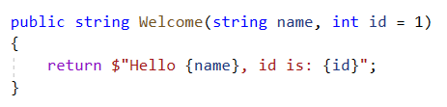
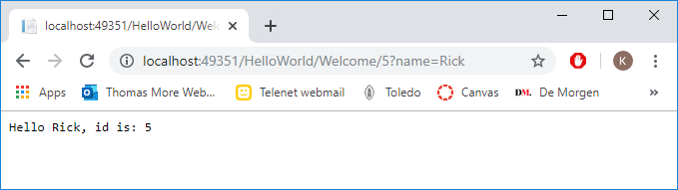
Parameters (2. url segment)

Slide 19
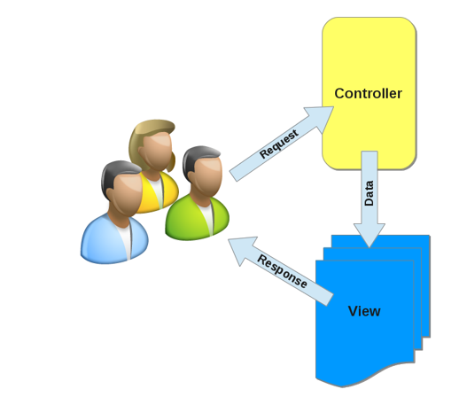
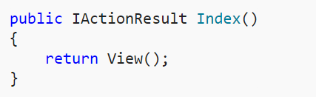
Adding a view
HelloWorldController.cs
Views folder | Add Folder | HelloWorld (controller name)
Helloworld | Add | New Item

Slide 20
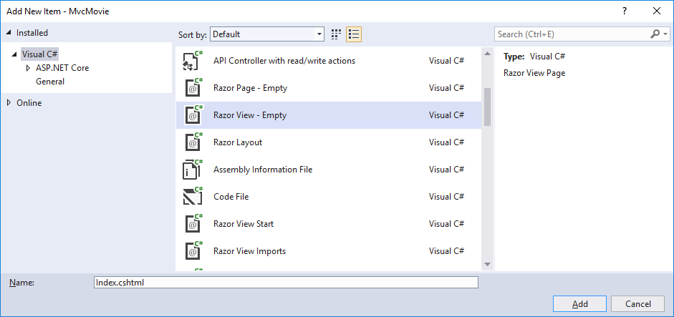
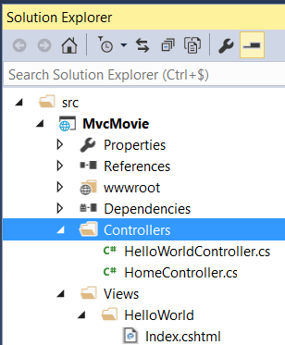
Adding a view
The name of the view = the name of the action from which the view is called

Slide 21
Adding a view
@{
ViewData["Title"] = "Index Title";
}
<h2>Index Header</h2>
<p>Hello from our Index View!</p>
ViewData is a Dictionary object that allows you to pass data between
Controller and View
View and View Template
Dictionary object contains a Key and a Value

Slide 22
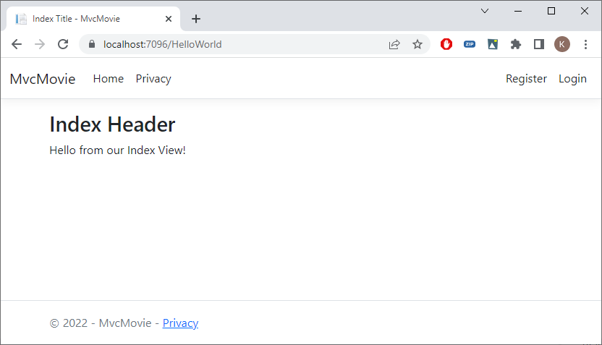
Adding a View
@{
ViewData["Title"] = "Index Title";
}
<h2>Index Header</h2>
<p>Hello from our Index View!</p>

Slide 23
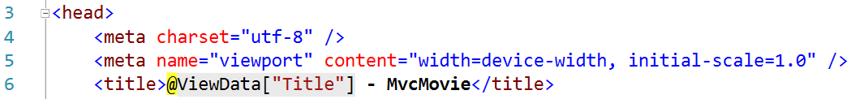
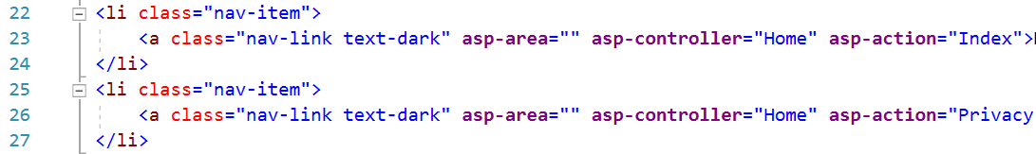
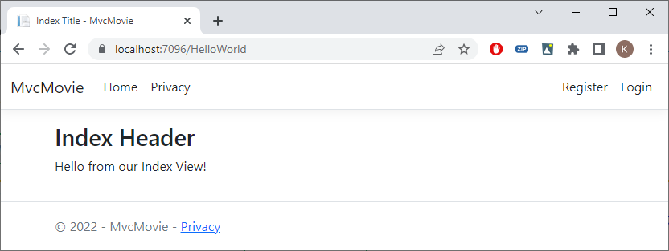
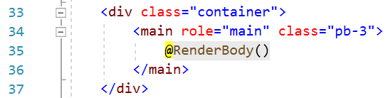
Layout Template
Views/Shared/_Layout.cshtml

Slide 24
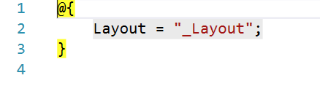
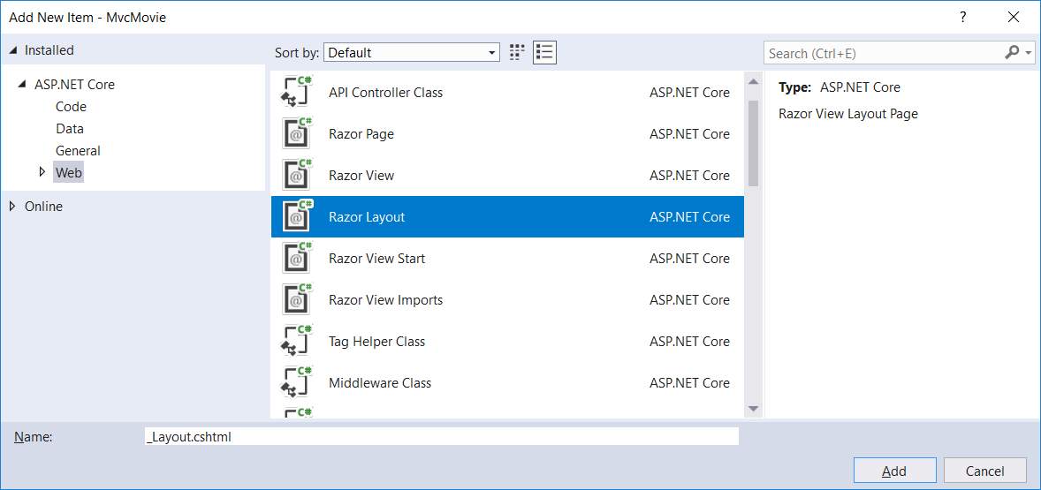
Setting the Layout Template
Views/_ViewStart.cshtml
Template without Bootstrap
Delete _Layout.cshtml
Shared | Add | New Item

Slide 25
Change the template (No Bootstrap for now)
<!DOCTYPE html>
<html>
<head>
<meta name="viewport" content="width=device-width" />
<title>@ViewData["Title"] - Mvc Movie</title>
</head>
<body>
<h1>Mvc Movie - @ViewData["Title"]</h1>
<div>
@RenderBody()
</div>
</body>
</html>

Slide 26
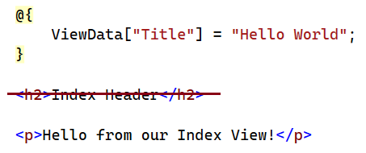
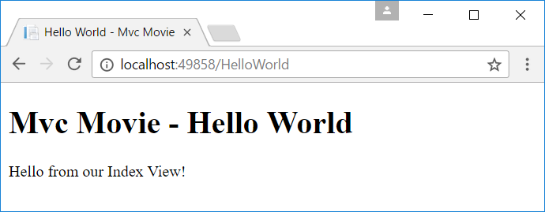
Change the view
<!DOCTYPE html>
<html>
<head>
<meta name="viewport" content="width=device-width" />
<title>@ViewData["Title"] - Mvc Movie</title>
</head>
<body>
<h1>Mvc Movie - @ViewData["Title"]</h1>
<div>
@RenderBody()
</div>
</body>
</html>
Index.shtml

Slide 27
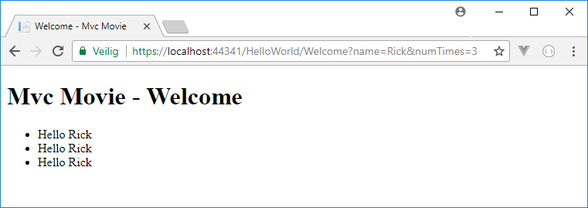
Passing data from the controller to View
HelloWorldController
Extra Razor View Welcome.cshtml
public IActionResult Welcome(string name, int numTimes = 1)
{
ViewData["Message"] = "Hello " + name;
ViewData["NumTimes"] = numTimes;
return View();
}
@{
ViewData["Title"] = "Welcome";
}
<ul>
@for (int i = 0; i < (int)ViewData["NumTimes"]; i++)
{
<li>@ViewData["Message"]</li>
}
</ul>

Slide 28
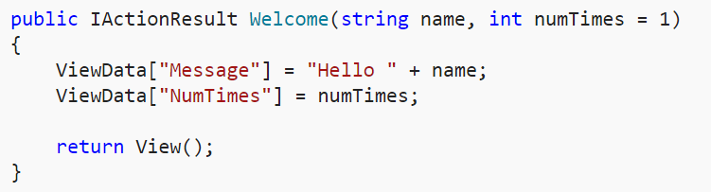
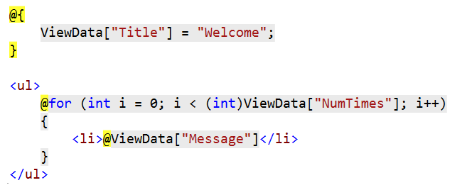
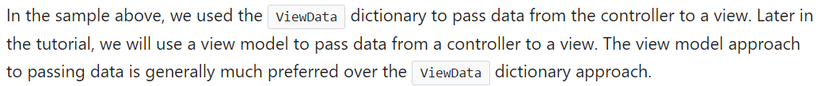
Passing Data from Controller to View

Slide 29
ASP.NET Razor Views
.cshtml
A Razor View contains
Html <html>
Razor @{ var name = "Jeff"; }
HTML helpers @Html.ActionLink("Movies", "List", "Movies")
TAG helpers <a asp-controller="Movies" asp-action="List">Movies</a>

Slide 30
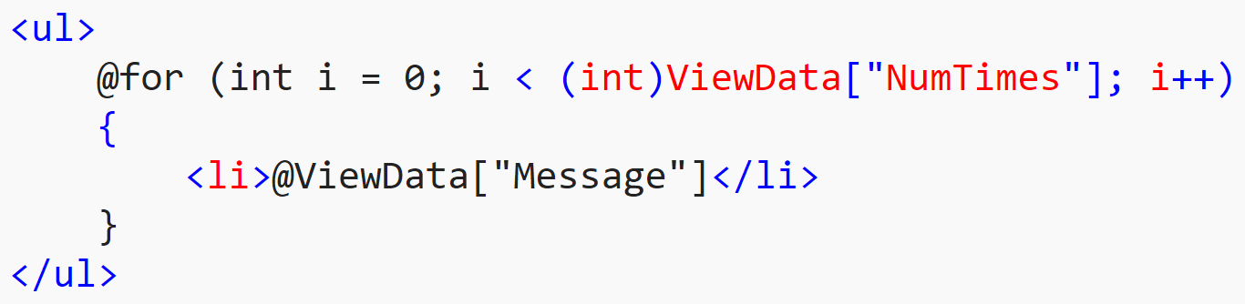
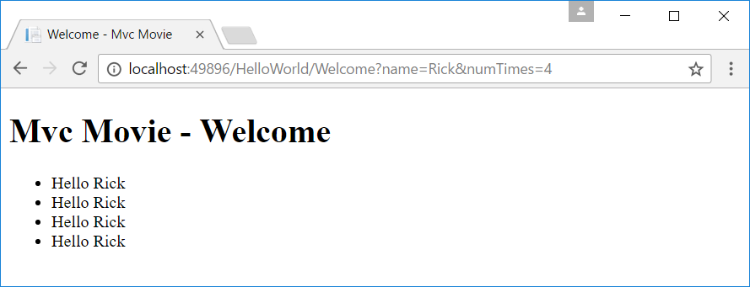
@Razor

Slide 31
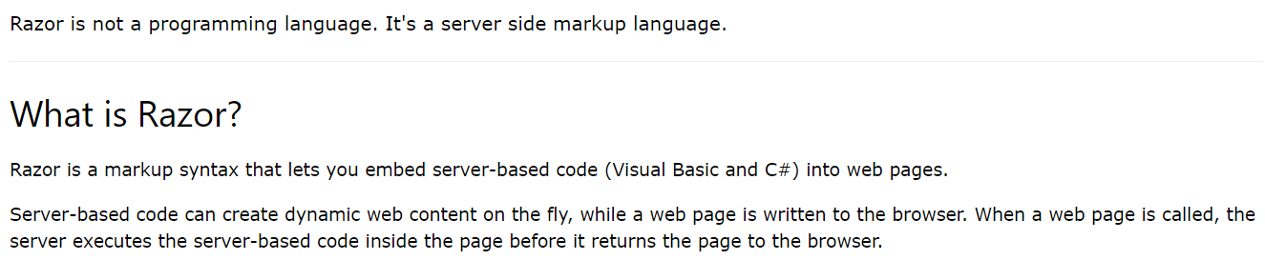
What is razor?

Slide 32
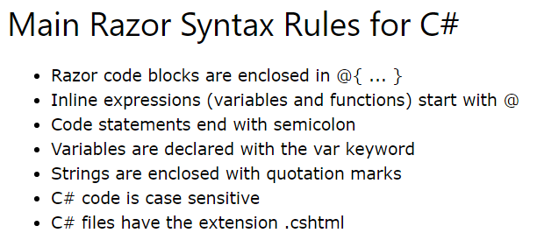
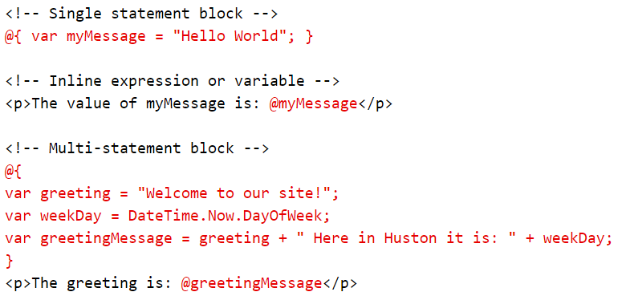
Razor Syntax

Slide 33
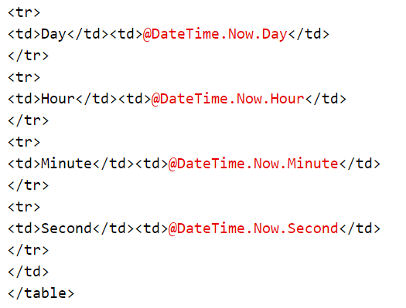
Razor Expressions: @( expression )

Slide 34
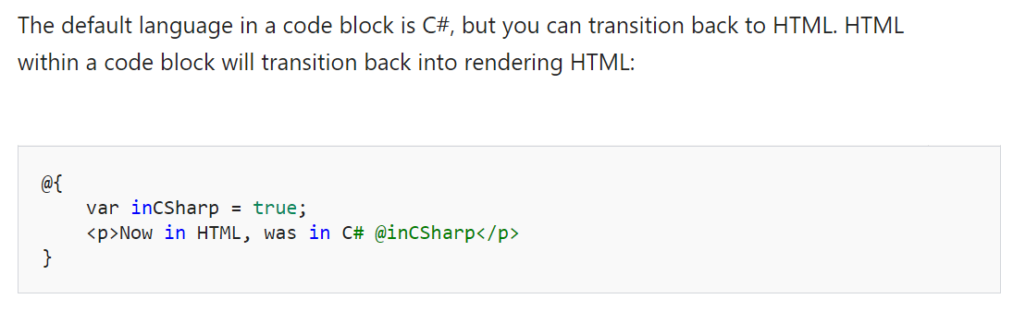
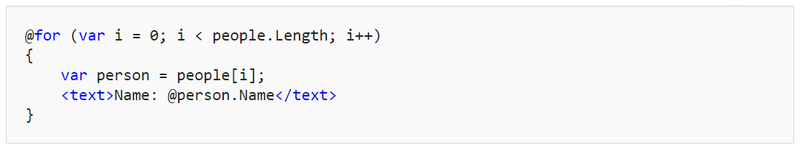
transitions

Slide 35
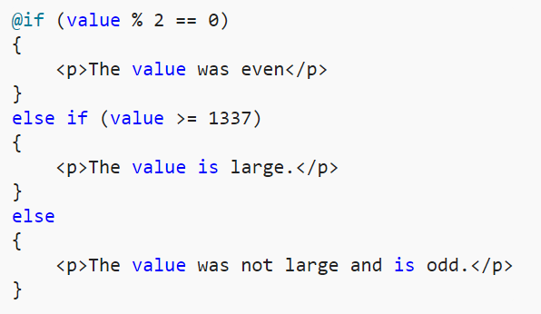
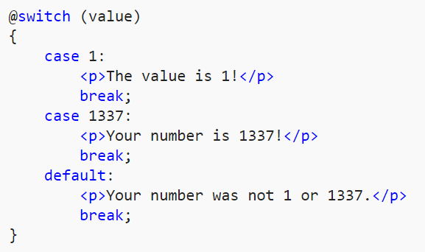
Control structures

Slide 36
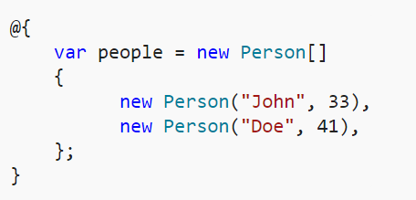
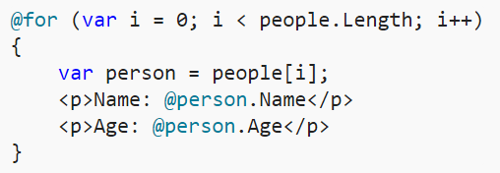
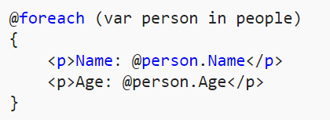
Looping

Slide 37
HTML & TAG Helpers
HTML Helper
@Html.ActionLink("Movies", "List", "Movies") // linkText, actionName, controllerName
TagHelper
<a asp-controller="Movies" asp-action="List">Movies</a>
Output in browser
<a href="/Movies/List">Movies</a>

Slide 38
URL Helper (to be used in the exercise)
@Html.ActionLink("Movies", "List", "Movies")
⇨Output in browser
<a href="/Movies/List">Movies</a>
@Url.Action("Movies", "Detail", new { id = 6 })
⇨ Output in browser
/Movies/Detail/6

Slide 39
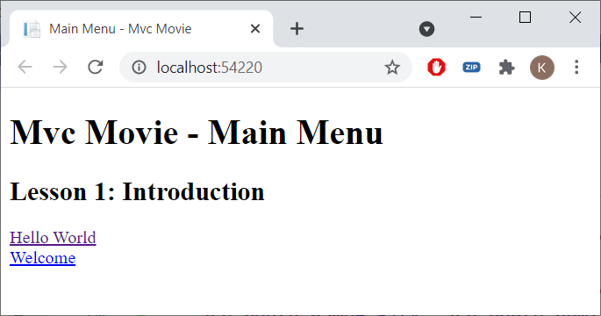
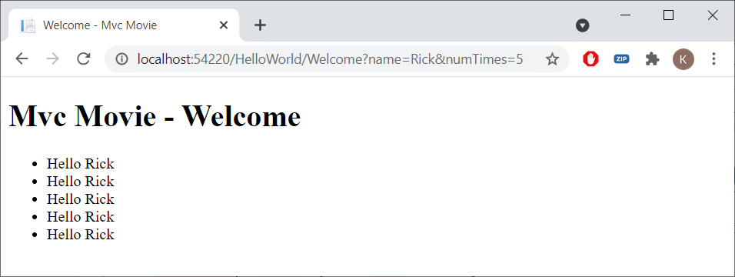
MVCMOvie Main Menu: Home/Index.cshtml
@{
ViewData["Title"] = "Main Menu";
}
<h2>Lesson 1: Introduction</h2>
<a asp-controller="HelloWorld" asp-action="Index">Hello World</a><br />
<a asp-controller="HelloWorld" asp-action="Welcome"
asp-route-name="Rick" asp-route-numTimes="5">Welcome</a><br />

Slide 40
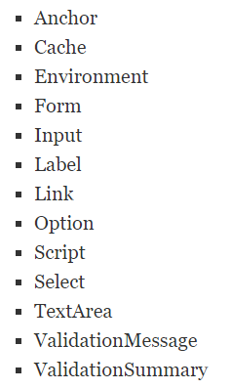
HTML & Tag Helpers (more to come)

Slide 41
Exercise
MotoGP Part 1

